Slide 1
Aggregation and Transformation of Vector-Valued Messages in the Shuffle Model of Differential Privacy
Mary Scott
Joint work with Graham Cormode and Carsten Maple
Accepted by British International Conference on Databases (BICOD)
Submitted to IEEE Transactions on Information Forensics and Security (TIFS)

Slide 2
Research Motivation
My research area is Privacy-Enhancing Technologies (PETs), with a particular focus on Differential Privacy (DP).
DP is a strong, mathematical definition of privacy in the context of statistical and machine learning analysis.
Provides mathematically provable guarantee of privacy protection against wide range of privacy attacks,
e.g. differencing attacks, linkage attacks, reconstruction attacks.
Ensures that any given disclosure is within a small multiplicative factor, whether or not an individual participates in the dataset.

Slide 3
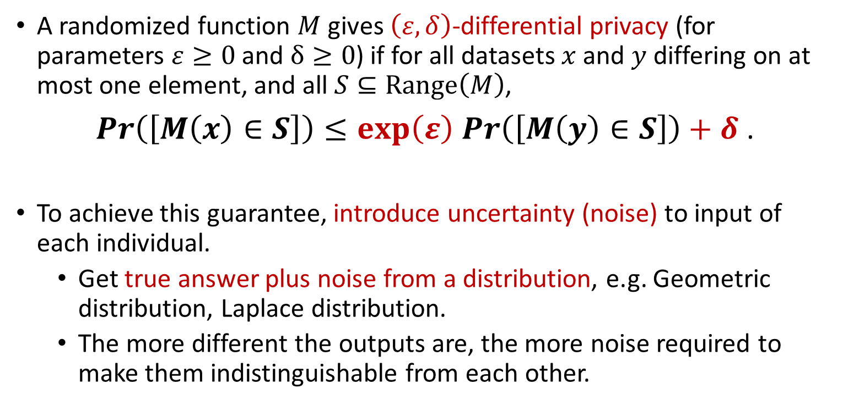
Research Motivation
A randomized function $M$ gives $\left(ε,δ\right)$-differential privacy (for parameters $ε≥0$ and $δ≥0$) if for all datasets $x$ and $y$ differing on at most one element, and all $S⊆Range\left(M\right)$,
$\operatorname{Pr}\left(\left[M\left(x\right)∈S\right]\right)≤\exp\left(ε\right)$ $\operatorname{Pr}\left(\left[M\left(y\right)∈S\right]\right)+δ$ .
To achieve this guarantee, introduce uncertainty (noise) to input of each individual.
Get true answer plus noise from a distribution, e.g. Geometric distribution, Laplace distribution.
The more different the outputs are, the more noise required to make them indistinguishable from each other.

Slide 4
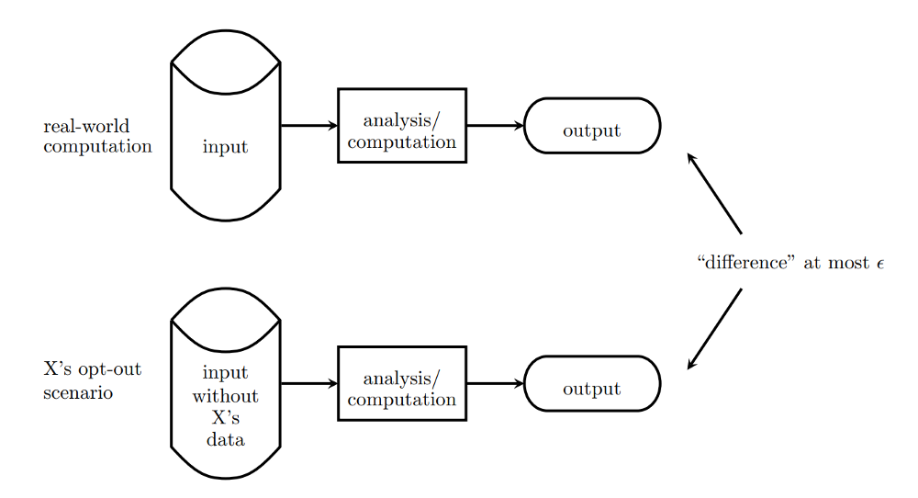
Research Motivation

Slide 5
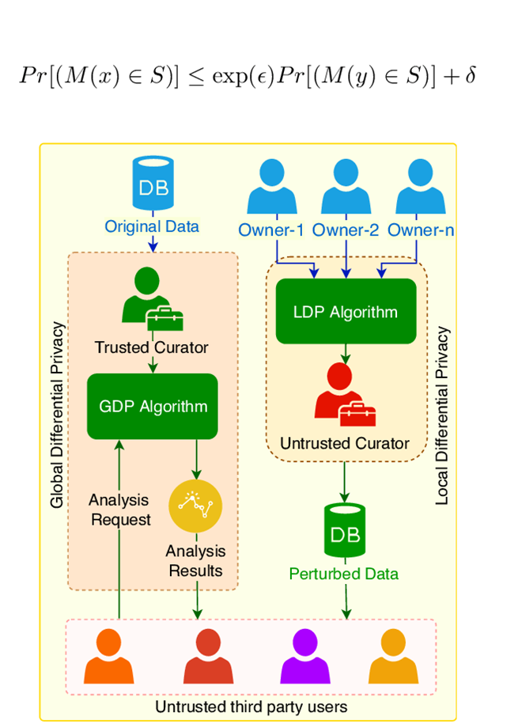
Models of Differential Privacy
Centralized Model of DP: users submit sensitive personal information directly to a trusted central data collector, who
adds random noise to raw data to provide DP,
and assembles and analyses the aggregated results.
Local Model of DP: each user applies a local randomizer to add random noise to their data before it is submitted.
No need for trusted party but noise required per user for same privacy guarantee is much higher.
Limits usage of Local Differential Privacy (LDP) to major companies, e.g. Google, Apple and Microsoft.
Neither provides a good balance between trust of central entity and level of noise required to guarantee DP.

Slide 6

The Shuffle Model of DP
The (Single-Message) Shuffle Model sits in between the Centralized and Local Models of DP:
noise required per user for same privacy guarantee is not as high as in the Local Model.
Introduces an additional “shuffling step” to the Local Model:
after the data from each user is encoded, it is randomly permuted to unbind each user from their data before analysis takes place.
Only introduced in 2019, there is much more work to be done.
Contrasts with general DP which was first defined in 2006.
Currently working on a protocol for vector-valued messages, extending an existing protocol only applicable for scalars.

Slide 7
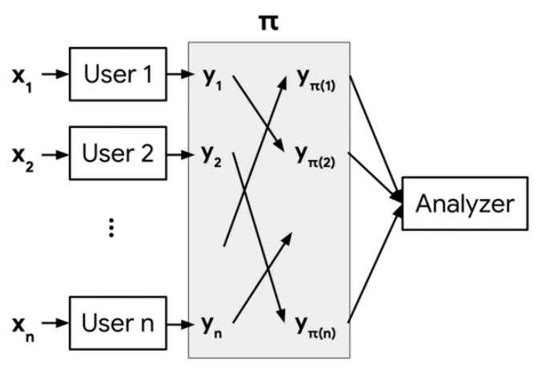
The Shuffle Model of DP

Slide 8
Extending the Shuffle Model to Vectors
Extended “The Privacy Blanket of the Shuffle Model” (Balle et al., 2019) to be applicable to vectors rather than just scalars.
Two contributions:
an optimal single message protocol for summation of real vectors in the Shuffle Model,
and an improvement of this bound through implementation of a Discrete Fourier Transform (DFT), which minimises initial error at expense of the loss in accuracy.
Can be extended to produce similar protocol for linearization of matrices and higher-dimensional tensors,
useful for representation of multi-dimensional data in Neural Networks.

Slide 9
Applications for Vector Data Collection
Why did I choose vectors specifically as the data type?
Practical applications in Federated Learning:
a Machine Learning (ML) setting where multiple users collaborate in solving a ML problem, under coordination of service provider.
e.g. training a Deep Neural Network to predict the next word that a user types,
where updates are high-dimensional vectors based on information from user’s private database.
Why did I investigate the aggregation of these vectors?
Closely related to Secure Aggregation:
used to privately compute outputs of local ML on user devices.
Example above requires only element-wise weighted averages of update vectors.

Slide 10
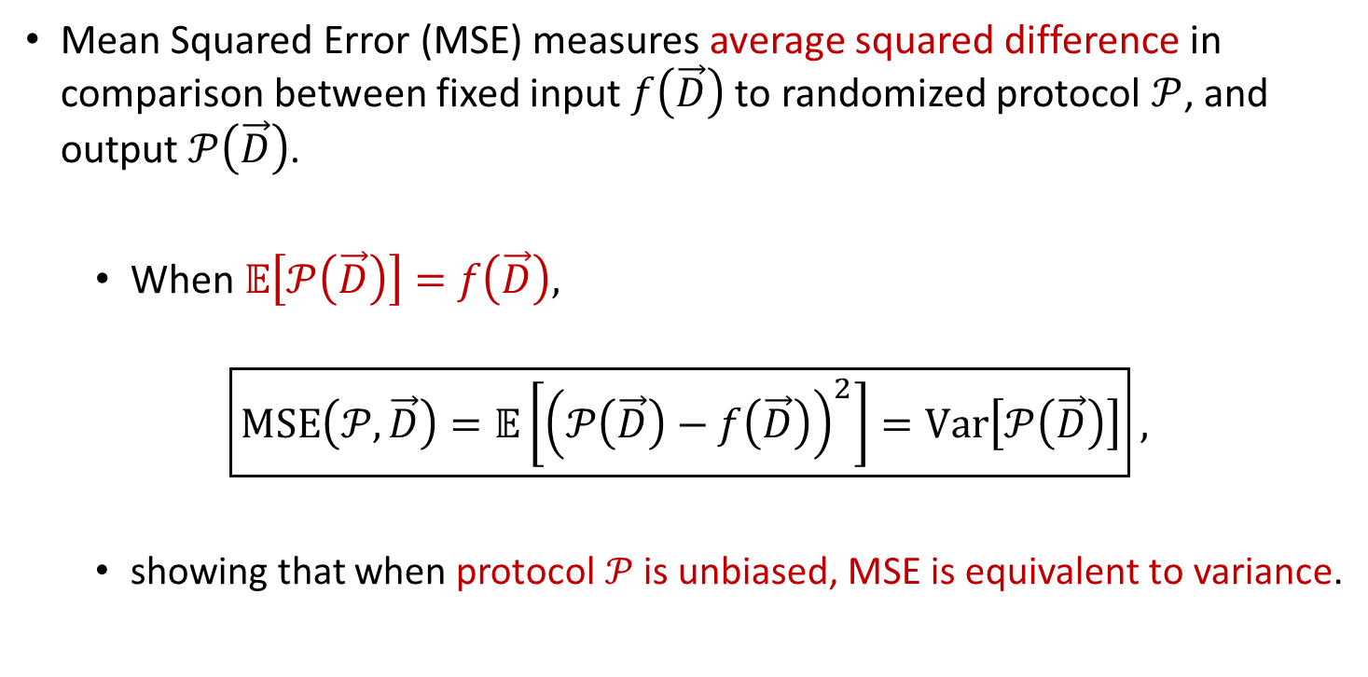
Accuracy Measure: Mean Squared Error (MSE)
Mean Squared Error (MSE) measures average squared difference in comparison between fixed input $f\left(\vec{D}\right)$ to randomized protocol $𝒫$, and output $𝒫\left(\vec{D}\right)$.
When $𝔼\left[𝒫\left(\vec{D}\right)\right]=$ $f\left(\vec{D}\right),$
$$\boxed{MSE\left(𝒫,\vec{D}\right)=𝔼\left[{\left(𝒫\left(\vec{D}\right)−f\left(\vec{D}\right)\right)}^{2}\right]=Var\left[𝒫\left(\vec{D}\right)\right]} ,$$
showing that when protocol $𝒫$is unbiased, MSE is equivalent to variance.

Slide 11
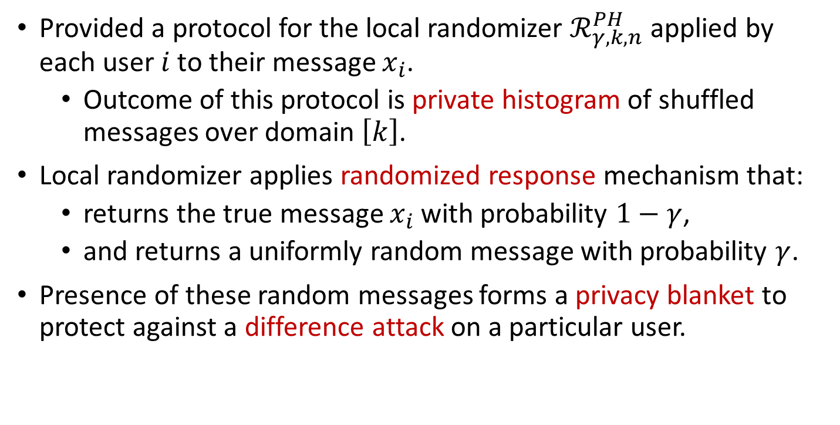
Protocol for the Local Randomizer
Provided a protocol for the local randomizer $ℛ_{γ,k,n}^{PH}$ applied by each user $i$ to their message $x_{i}$.
Outcome of this protocol is private histogram of shuffled messages over domain $\left[k\right]$.
Local randomizer applies randomized response mechanism that:
returns the true message $x_{i}$ with probability $1−γ$,
and returns a uniformly random message with probability $γ$.
Presence of these random messages forms a privacy blanket to protect against a difference attack on a particular user.

Slide 12
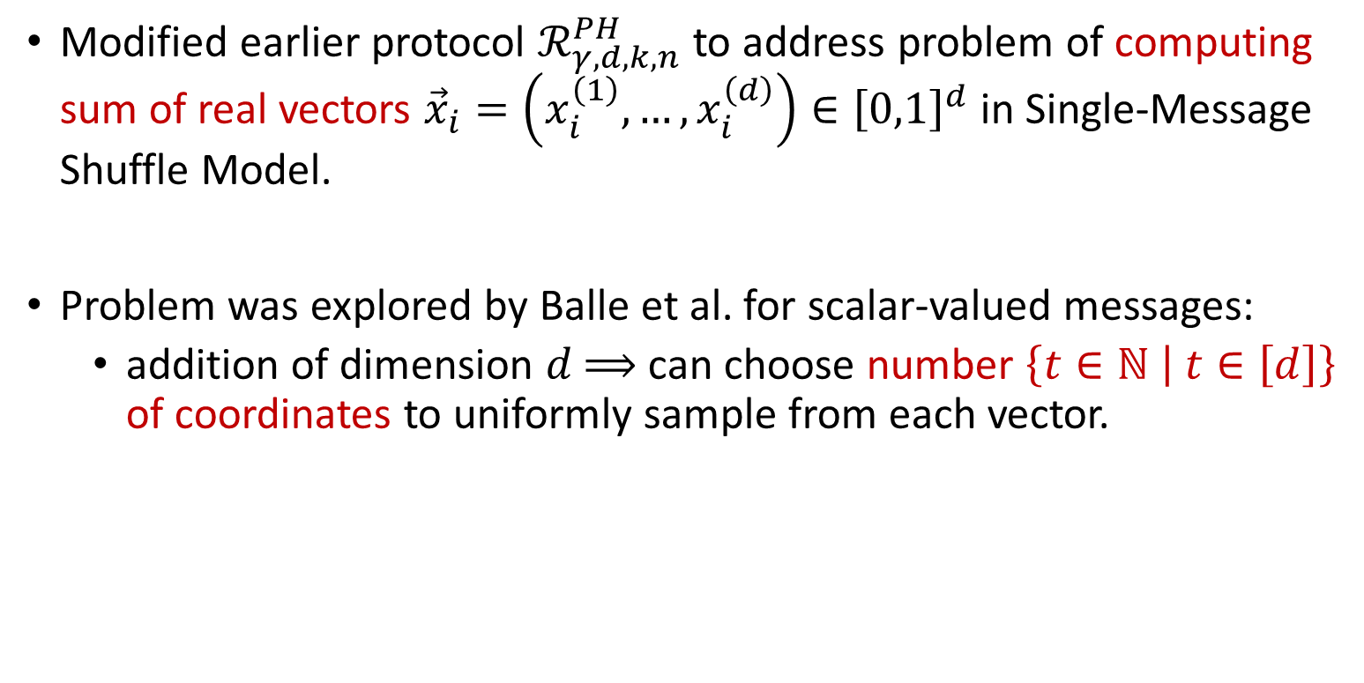
Modified Protocol for the Local Randomizer
Modified earlier protocol $ℛ_{γ,d,k,n}^{PH}$ to address problem of computing sum of real vectors ${\vec{x}}_{i}=\left(x_{i}^{\left(1\right)},…,x_{i}^{\left(d\right)}\right)∈{\left[0,1\right]}^{d}$ in Single-Message Shuffle Model.
Problem was explored by Balle et al. for scalar-valued messages:
addition of dimension $d$ $⟹$ can choose number $\left\{t∈ℕ | t∈\left[d\right]\right\}$ of coordinates to uniformly sample from each vector.

Slide 13
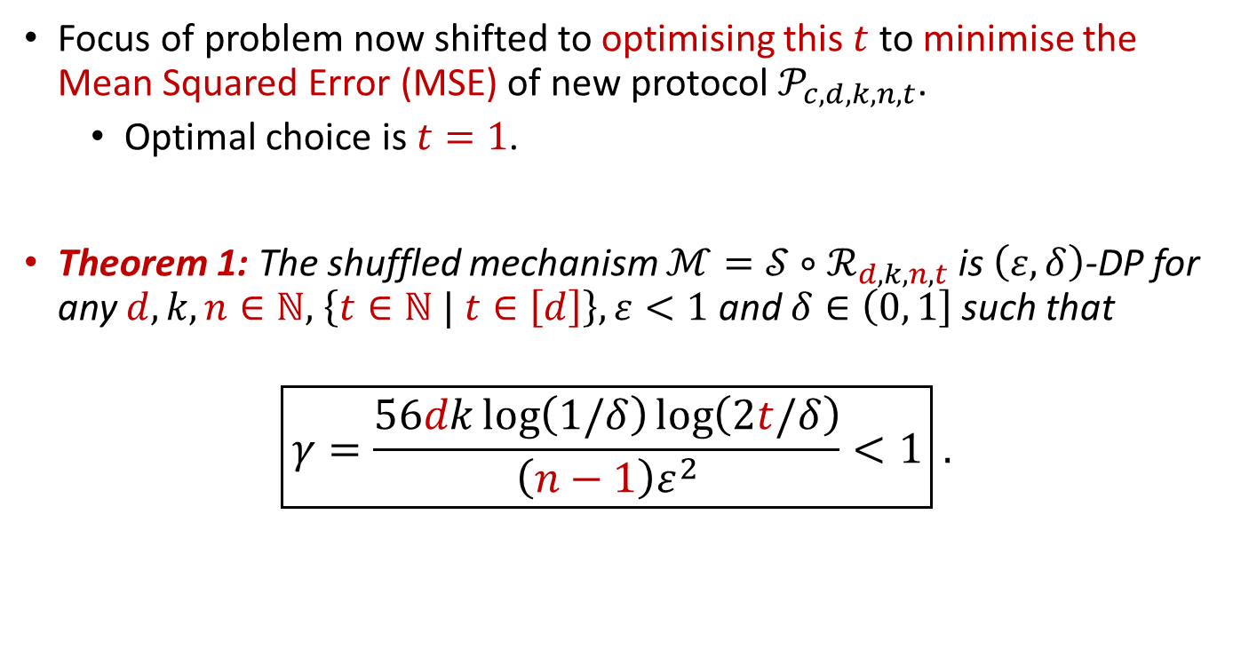
Privacy Analysis of Modified Protocol
Focus of problem now shifted to optimising this $t$ to minimise the Mean Squared Error (MSE) of new protocol $𝒫_{c,d,k,n,t}$.
Optimal choice is $t=1$.
Theorem 1: The shuffled mechanism $ℳ=𝒮∘ℛ_{d,k,n,t}$ is $\left(ε,δ\right)$-DP for any $d,k,n∈ℕ,$ $\left\{t∈ℕ | t∈\left[d\right]\right\},ε<1$ and $δ∈\left(0,\left.1\right]\right.$ such that
$$\boxed{γ=\frac{56dk\log\left(1/δ\right)\log\left(2t/δ\right)}{\left(n−1\right)ε^{2}}<1} .$$

Slide 14
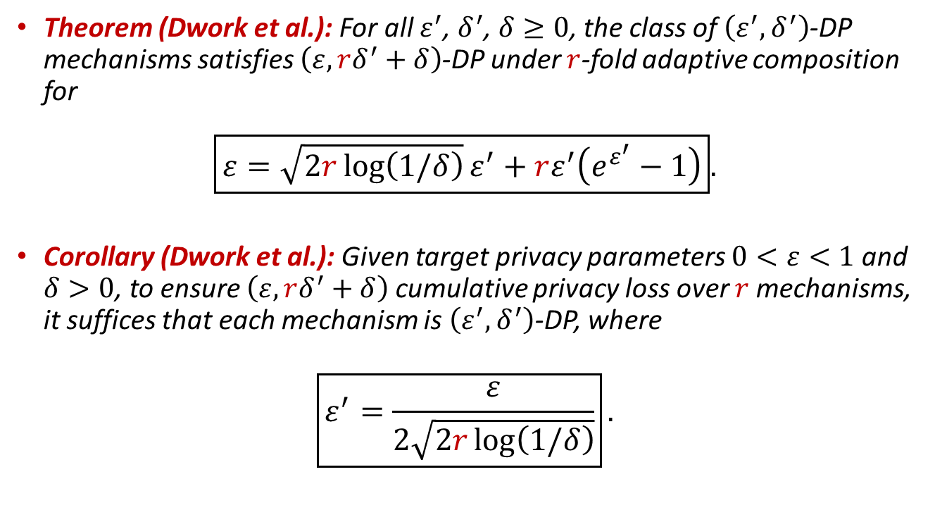
Advanced Composition Results Used
Theorem (Dwork et al.): For all $ε^{′}$, $δ^{′}$, $δ≥0$, the class of $\left(ε^{′},δ^{′}\right)$-DP mechanisms satisfies $\left(ε, rδ^{′}+δ\right)$-DP under $r$-fold adaptive composition for
$$\boxed{ε=\sqrt{2r\log\left(1/δ\right)}ε^{′}+rε^{′}\left(e^{ε^{′}}−1\right)}.$$
Corollary (Dwork et al.): Given target privacy parameters $0<ε<1$ and $δ>0$, to ensure $\left(ε, rδ^{′}+δ\right)$ cumulative privacy loss over $r$ mechanisms, it suffices that each mechanism is $\left(ε^{′},δ^{′}\right)$-DP, where
$$\boxed{ε^{′}=\frac{ε}{2\sqrt{2r\log\left(1/δ\right)}}}.$$

Slide 15
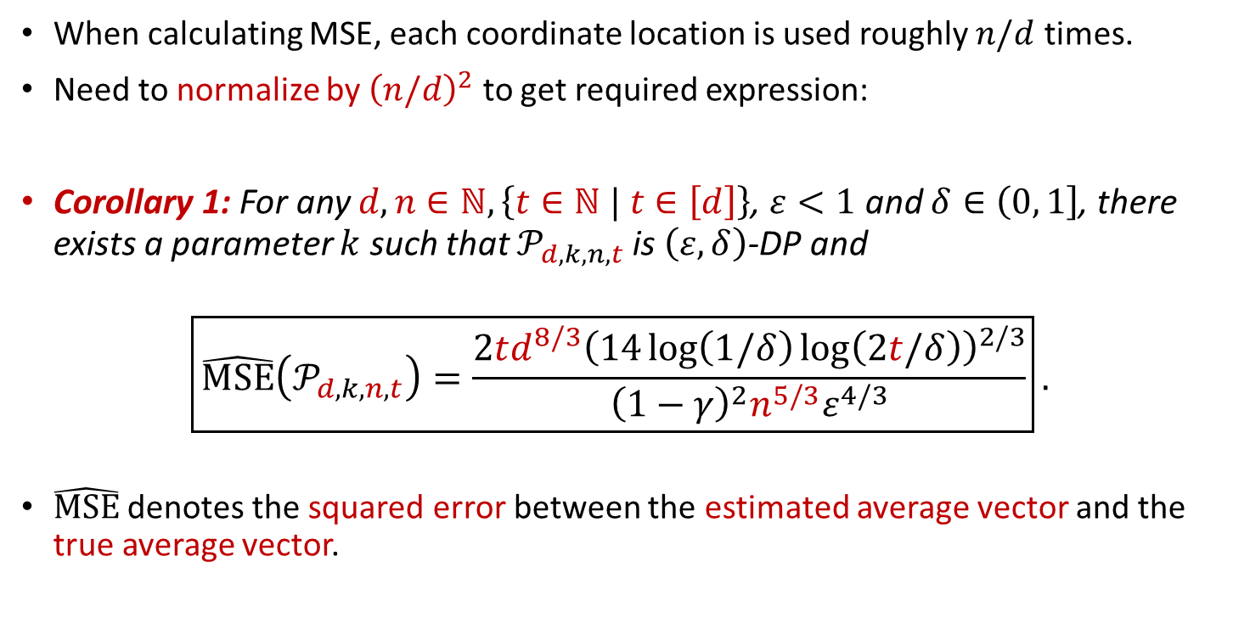
Normalizing the Mean Squared Error (MSE)
When calculating MSE, each coordinate location is used roughly $n/d$ times.
Need to normalize by ${\left(n/d\right)}^{2}$ to get required expression:
Corollary 1: For any $d,n∈ℕ,\left\{t∈ℕ | t∈\left[d\right]\right\}$, $ε<1$ and $δ∈\left(0,\left.1\right]\right.$, there exists a parameter $k$ such that $𝒫_{d,k,n,t}$ is $\left(ε,δ\right)$-DP and
$$\boxed{\hat{MSE}\left(𝒫_{d,k,n,t}\right)=\frac{2td^{8/3}{\left(14\log\left(1/δ\right)\log\left(2t/δ\right)\right)}^{2/3}}{{\left(1−γ\right)}^{2}n^{5/3}ε^{4/3}}}.$$
$\hat{MSE}$ denotes the squared error between the estimated average vector and the true average vector.

Slide 16
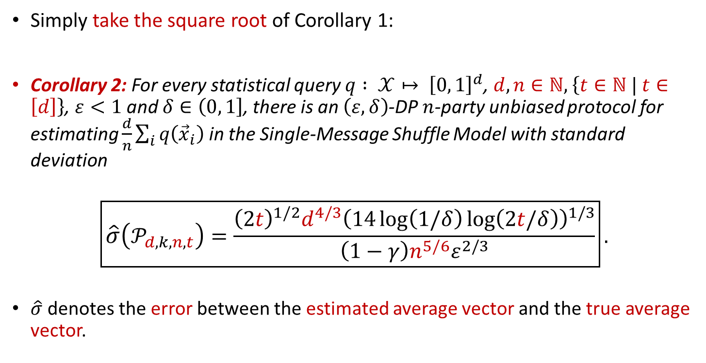
Useful Error: Between Average Vectors
Simply take the square root of Corollary 1:
Corollary 2: For every statistical query $q : 𝒳↦ {\left[0, 1\right]}^{d}$, $d,n∈ℕ,$ $\left\{t∈ℕ | t∈\left[d\right]\right\}$, $ε<1$ and $δ∈\left(0,\left.1\right]\right.$, there is an $\left(ε,δ\right)$-DP $n$-party unbiased protocol for estimating $\frac{d}{n}\sum_{i}{q\left({\vec{x}}_{i}\right)}$ in the Single-Message Shuffle Model with standard deviation
$$\boxed{\hat{σ}\left(𝒫_{d,k,n,t}\right)=\frac{{{\left(2t\right)}^{1/2}d}^{4/3}{\left(14\log\left(1/δ\right)\log\left(2t/δ\right)\right)}^{1/3}}{\left(1−γ\right)n^{5/6}ε^{2/3}}}.$$
$\hat{σ}$ denotes the error between the estimated average vector and the true average vector.

Slide 17
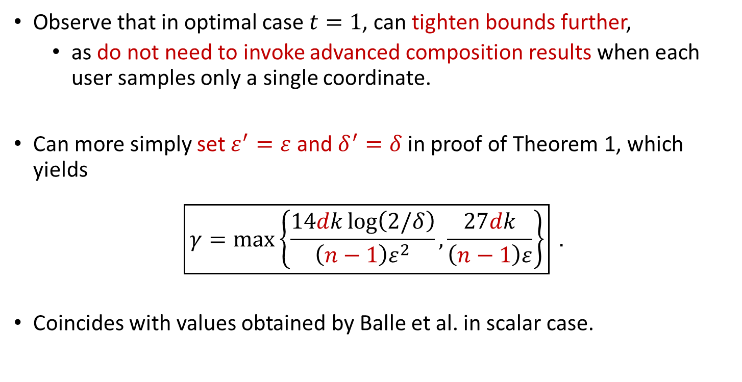

Improved Bounds for $t=1$
Observe that in optimal case $t=1$, can tighten bounds further,
as do not need to invoke advanced composition results when each user samples only a single coordinate.
Can more simply set $ε^{′}=ε$ and $δ^{′}=δ$ in proof of Theorem 1, which yields
$$\boxed{γ=\max\left\{\frac{14dk\log\left(2/δ\right)}{\left(n−1\right)ε^{2}},\frac{27dk}{\left(n−1\right)ε}\right\}} .$$
Coincides with values obtained by Balle et al. in scalar case.

Slide 18
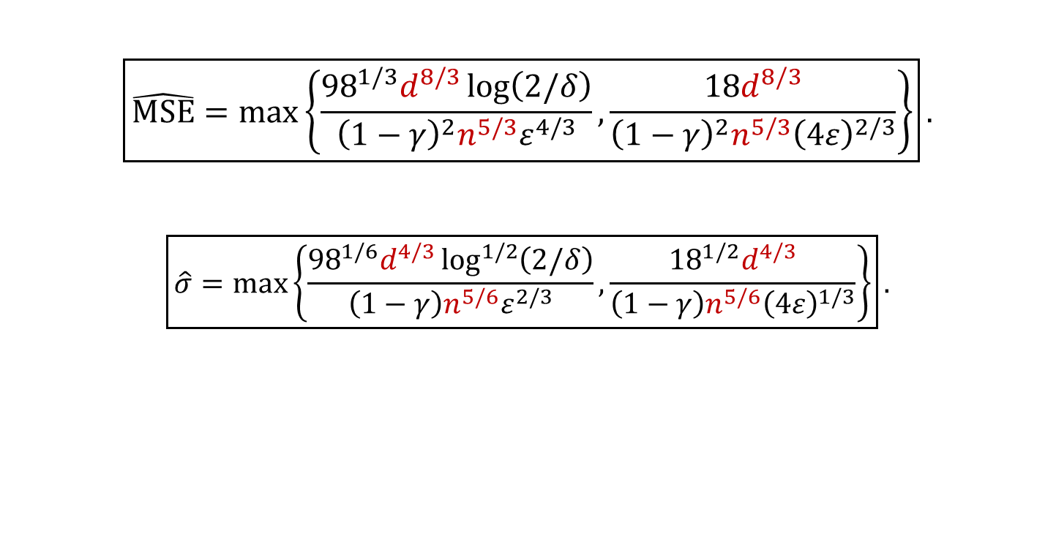
Improved Bounds for $t=1$
$$\boxed{\hat{MSE}=\max\left\{\frac{{98}^{1/3}d^{8/3}\log\left(2/δ\right)}{{\left(1−γ\right)}^{2}{n^{5/3}ε}^{4/3}},\frac{18d^{8/3}}{{\left(1−γ\right)}^{2}{n^{5/3}\left(4ε\right)}^{2/3}}\right\}}.$$
$$\boxed{\hat{σ}=\max\left\{\frac{{98}^{1/6}d^{4/3}\log^{1/2}\left(2/δ\right)}{\left(1−γ\right){n^{5/6}ε}^{2/3}},\frac{{18}^{1/2}d^{4/3}}{{\left(1−γ\right)n^{5/6}\left(4ε\right)}^{1/3}}\right\}}.$$

Slide 19
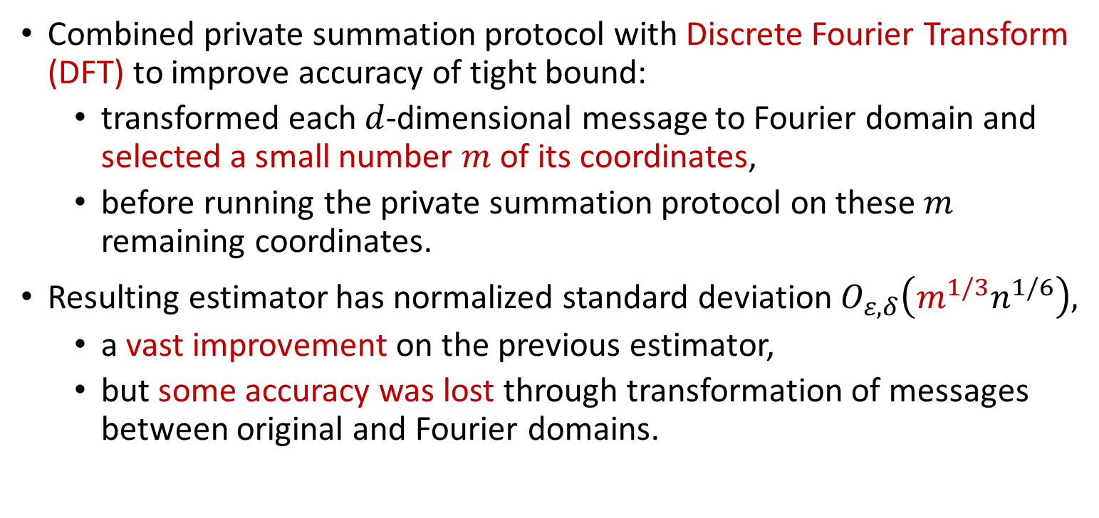
Adding a Discrete Fourier Transform
Combined private summation protocol with Discrete Fourier Transform (DFT) to improve accuracy of tight bound:
transformed each $d$-dimensional message to Fourier domain and selected a small number $m$ of its coordinates,
before running the private summation protocol on these $m$ remaining coordinates.
Resulting estimator has normalized standard deviation $O_{ε,δ}\left(m^{1/3}n^{1/6}\right),$
a vast improvement on the previous estimator,
but some accuracy was lost through transformation of messages between original and Fourier domains.

Slide 20
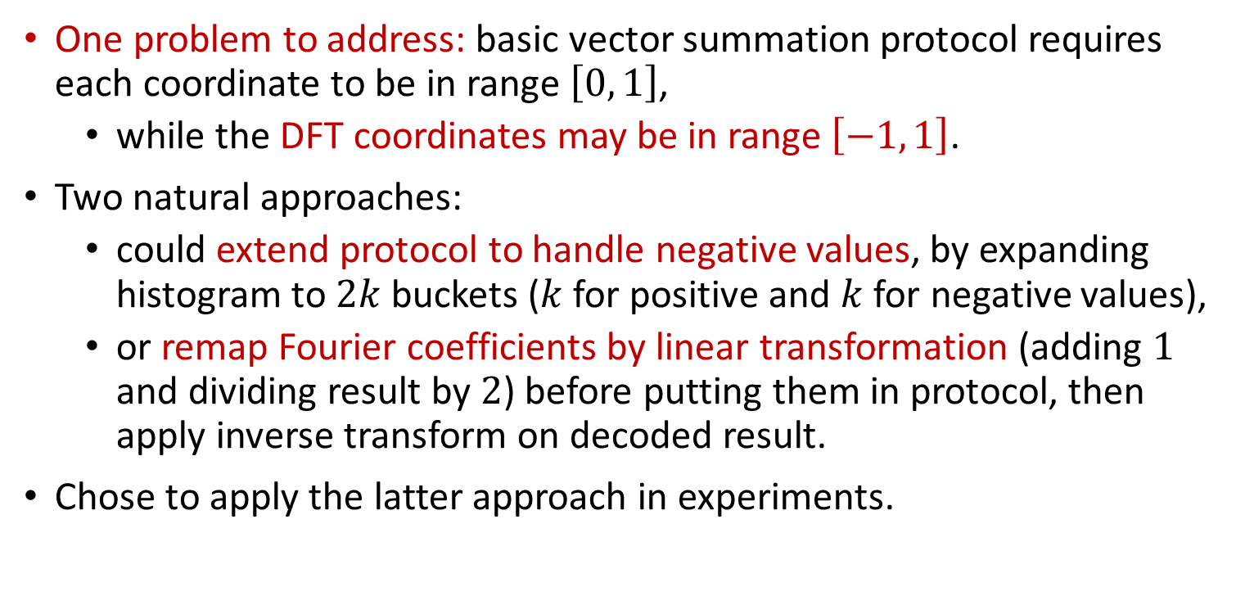
Adding a Discrete Fourier Transform
One problem to address: basic vector summation protocol requires each coordinate to be in range $\left[0, 1\right]$,
while the DFT coordinates may be in range $\left[−1, 1\right]$.
Two natural approaches:
could extend protocol to handle negative values, by expanding histogram to $2k$ buckets ($k$ for positive and $k$ for negative values),
or remap Fourier coefficients by linear transformation (adding $1$ and dividing result by $2$) before putting them in protocol, then apply inverse transform on decoded result.
Chose to apply the latter approach in experiments.

Slide 21
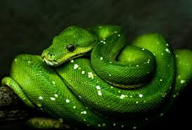
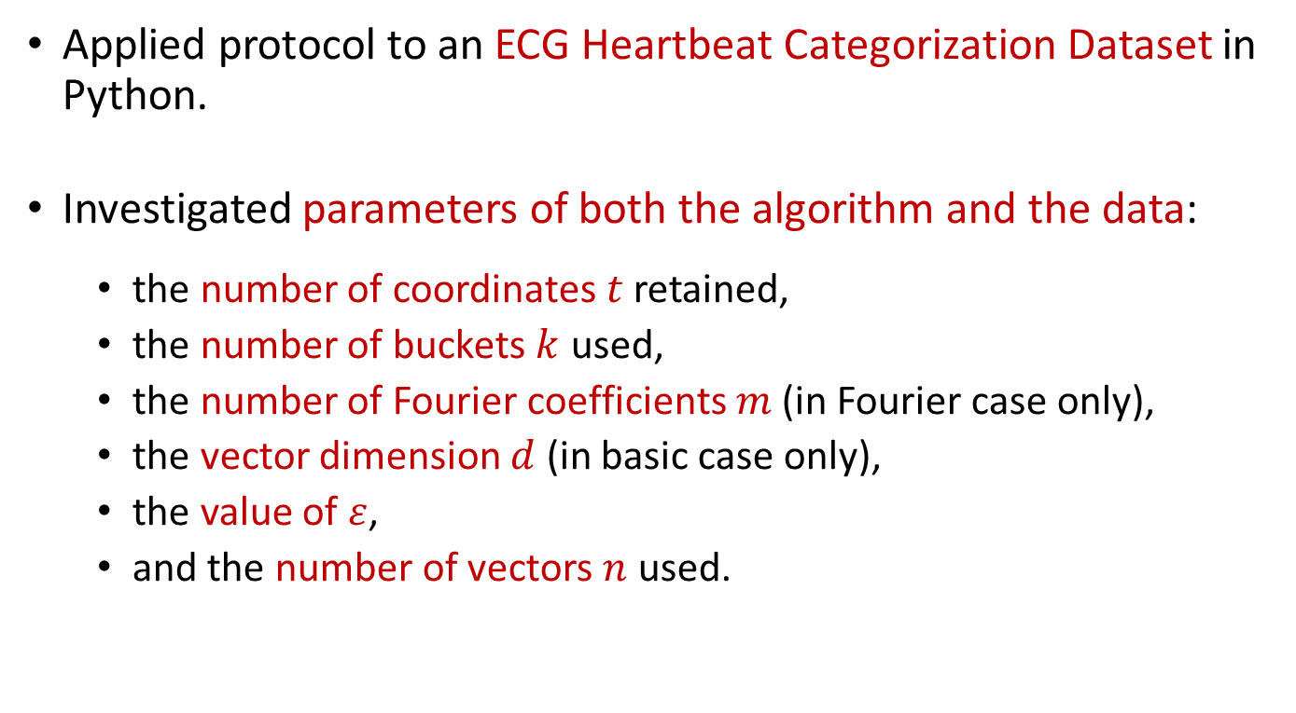
Experimental Evaluation
Applied protocol to an ECG Heartbeat Categorization Dataset in Python.
Investigated parameters of both the algorithm and the data:
the number of coordinates $t$ retained,
the number of buckets $k$ used,
the number of Fourier coefficients $m$ (in Fourier case only),
the vector dimension $d$ (in basic case only),
the value of $ε$,
and the number of vectors $n$ used.

Slide 22
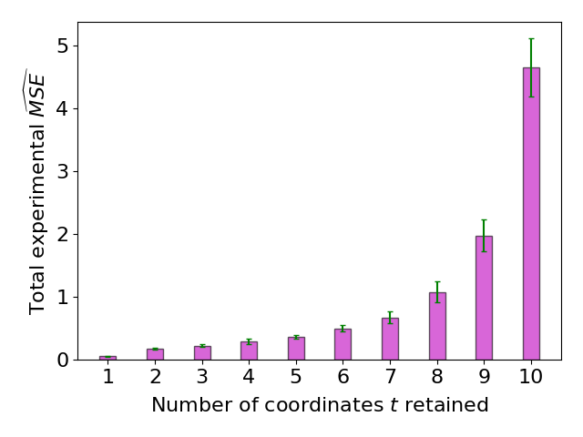
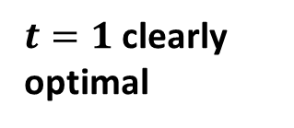
$t=1$ clearly optimal

Slide 23
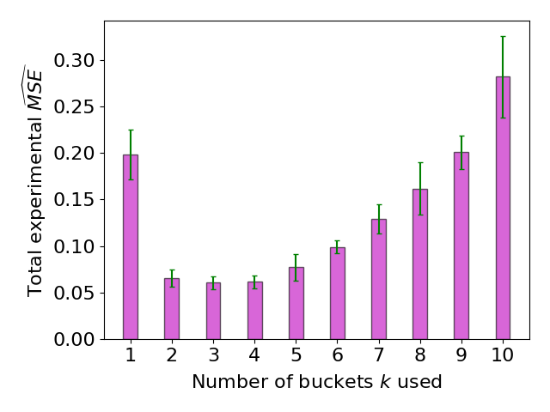
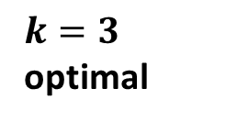
$k=3$ optimal

Slide 24
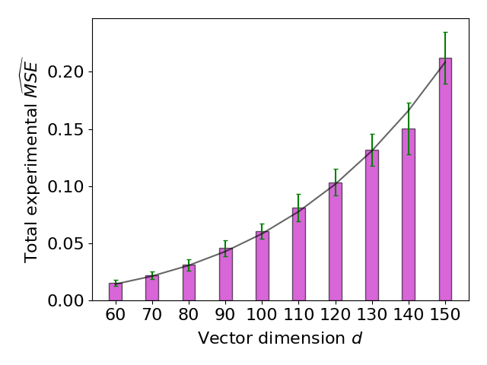
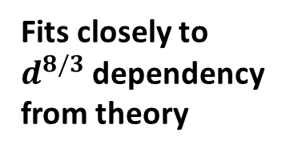
Fits closely to $d^{8/3}$ dependency from theory

Slide 25
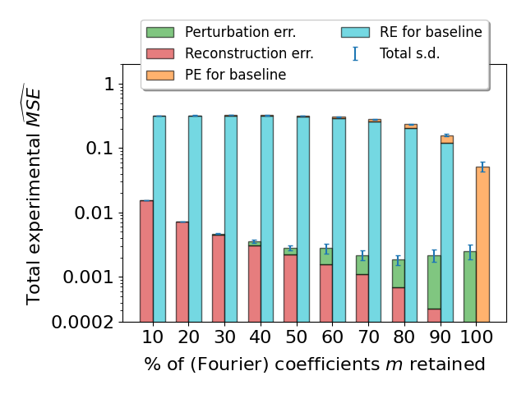

Slide 26
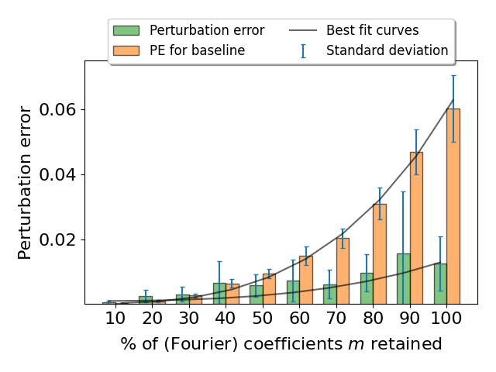

Slide 27
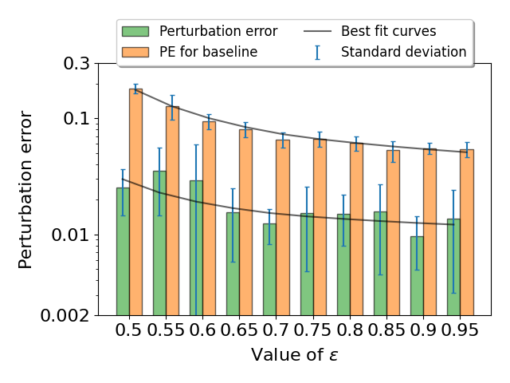

Slide 28
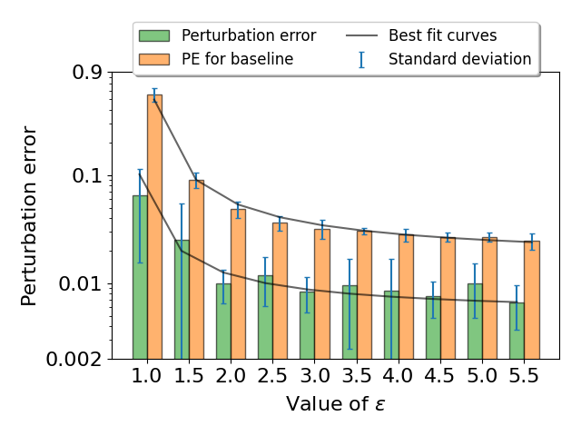

Slide 29
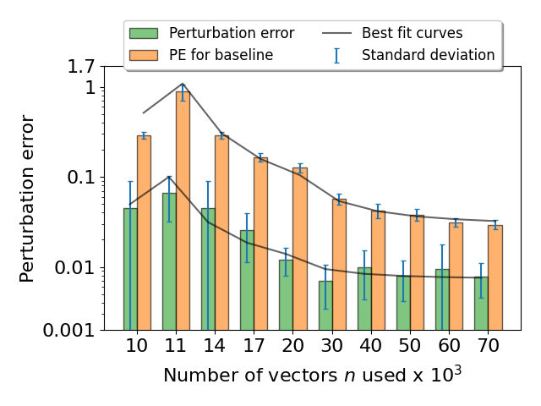

Slide 30
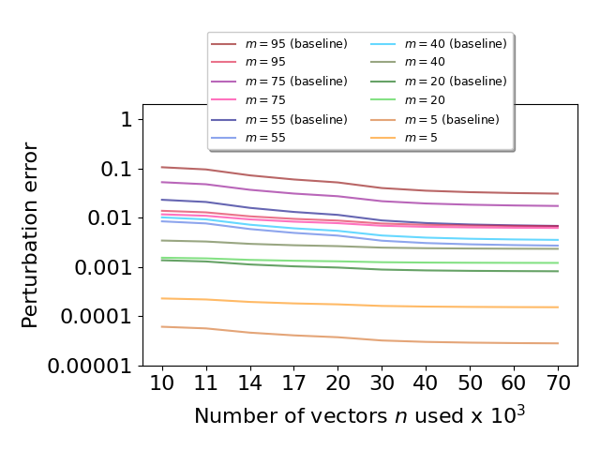

Slide 31
Current and Future Projects
Internship with the Alan Turing Institute:
provide key insights into synthetic data generation, federated learning and privacy-efficacy trade-offs
understand the impact of statistical heterogeneity in federated learning systems on efficacy and privacy
Possible Future Topics:
Secure Aggregation (applied to Shuffle Model)
Regression (minimal distance from all vectors)
Fourier with Shuffle (to intrinsically provide privacy)
Mechanism of Shuffle (multiparty computation)

Slide 32
Thank you for listening ☺
Any questions?

